Slide 1

Housing Element Status Update
Diversity, Equity, and Inclusion Committee Meeting
March 13, 2024

Slide 2
What is the Housing Element?
One of the seven General Plan elements
Updated every 8 years
Department of Housing and Community Development (HCD) review
Contents:
“Community Profile”
Assesses current and future housing needs
Demographics – Population, Households, Special Needs Groups, Housing Stock
“Housing Constraints”
Identifies constraints – Governmental and Non-Governmental
“Housing Resources”
Identifies “housing sites” that can accommodate City’s RHNA
“Housing Plan”
Provides a comprehensive strategy that establishes goals, policies, and “programs”

Slide 3
Regional Housing Needs Allocation (RHNA) for 2021-2029
Income Category | 5th Cycle Carryover | 6th Cycle RHNA | Total RHNA | Percent
Extremely/Very Low Income | 18 | 189 | 207 | 39.7%
Low Income | 11 | 88 | 99 | 19.0%
Moderate Income | 0 | 84 | 84 | 16.1%
Above Moderate Income | 0 | 131 | 131 | 25.1%
Total | 29 | 492 | 521 | 100.0%

Slide 4
Housing Solutions
Accessory Dwelling Units (ADU)
Entitled Projects
Sites Inventory/Rezoning

Slide 5
Housing Solutions
Accessory Dwelling Units (ADU)
Entitled Projects
Sites Inventory/Rezoning
2021 – 21 applications
2022 – 44 applications
2023 – 31 applications

Slide 6
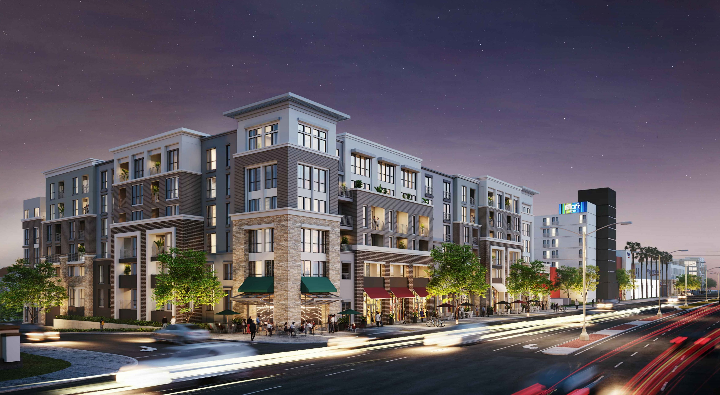
Housing Solutions
Accessory Dwelling Units (ADU)
Approved Projects
Sites Inventory/Rezoning
Pacific Coast Commons
263 units
(32 affordable)

Slide 7
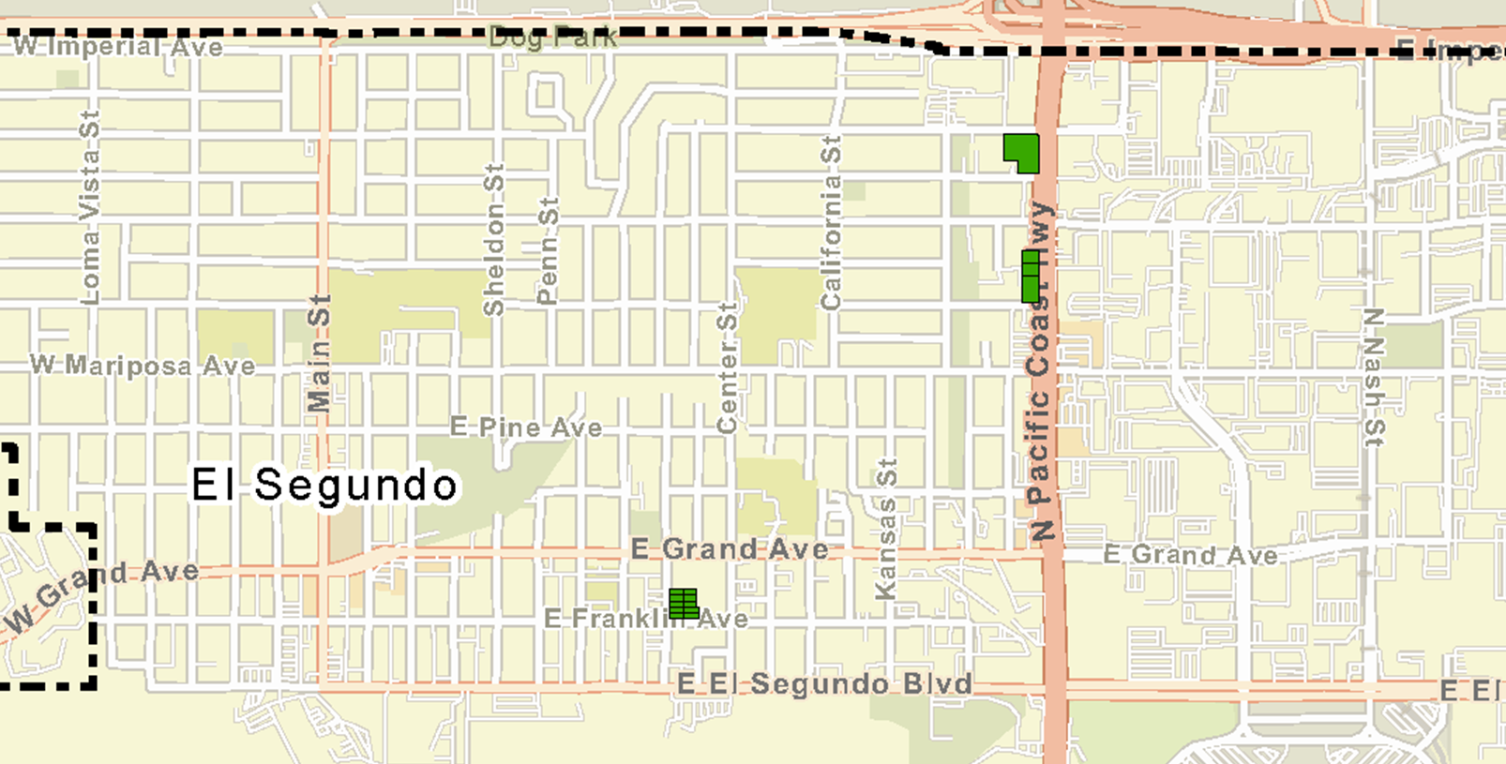
Sites Inventory – Rezoning program
Mixed-Use Overlay

Slide 8
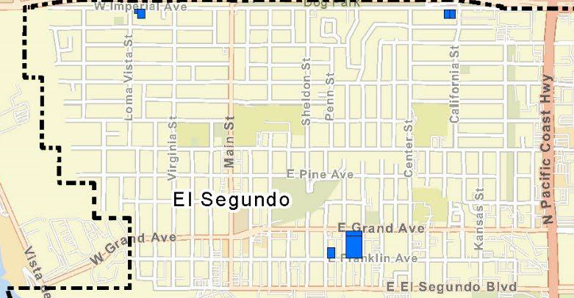
Sites Inventory – Rezoning program
Housing Overlay
(Phase 1)
Notes:
The second overlay will be our Housing Overlay that will rezone 5 individual sites that are currently zoned medium density residential (multi-family – R-3). Today, the R-3 top density is 27 units per acre. The Housing Overlay will allow densities between 60 and 70 units per acre.
Based on the proposed densities the rezoning may result in up to 1,065 units theoretically (in practice property owners, developers and the market determine what will actually be built.
This was a quick summary of the potential locations and types of new housing that will help El Segundo meet its RHNA goals.
Next I will be discussing more broadly, all the Housing Programs

Slide 9
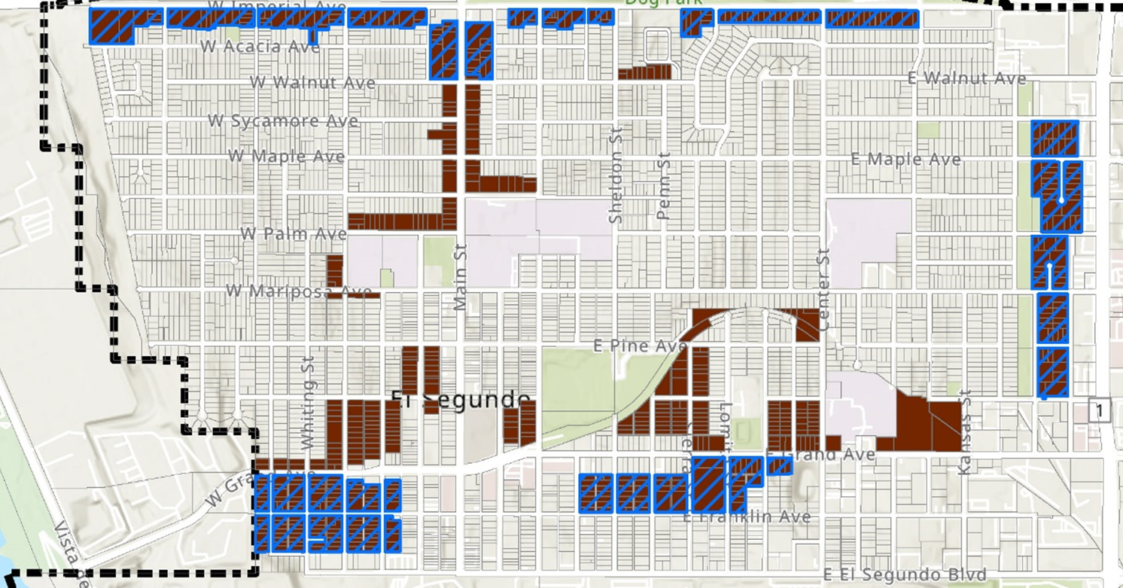
Sites Inventory – Rezoning program
Housing Overlay
(Potential Phase 2)

Slide 10
Housing Programs/Plan
Residential Sound Insulation (RSI)
Code Compliance Inspection Program
Accessory Dwelling Units (ADU)
Inclusionary Housing Ordinance and Affordable Housing Strategy
Urban Lot Split
Provision of Adequate Sites
Monitoring of No Net Loss
Lot Consolidation
El Segundo Municipal Code Amendments
Community Outreach
Fair Housing

Slide 11
Housing Programs/Plan
Residential Sound Insulation (RSI)
Code Compliance Inspection Program
Accessory Dwelling Units (ADU)
Inclusionary Housing Ordinance and Affordable Housing Strategy
Urban Lot Split
Provision of Adequate Sites
Monitoring of No Net Loss
Lot Consolidation
El Segundo Municipal Code Amendments
Community Outreach
Fair Housing

Slide 12
Housing Programs/Plan
Residential Sound Insulation (RSI)
Code Compliance Inspection Program
Accessory Dwelling Units (ADU)
Inclusionary Housing Ordinance and Affordable Housing Strategy
Urban Lot Split
Provision of Adequate Sites
Monitoring of No Net Loss
Lot Consolidation
El Segundo Municipal Code Amendments
Community Outreach
Fair Housing

Slide 13
Housing Programs/Plan
Residential Sound Insulation (RSI)
Code Compliance Inspection Program
Accessory Dwelling Units (ADU)
Inclusionary Housing Ordinance and Affordable Housing Strategy
Urban Lot Split
Provision of Adequate Sites
Monitoring of No Net Loss
Lot Consolidation
El Segundo Municipal Code Amendments
Community Outreach
Fair Housing

Slide 14
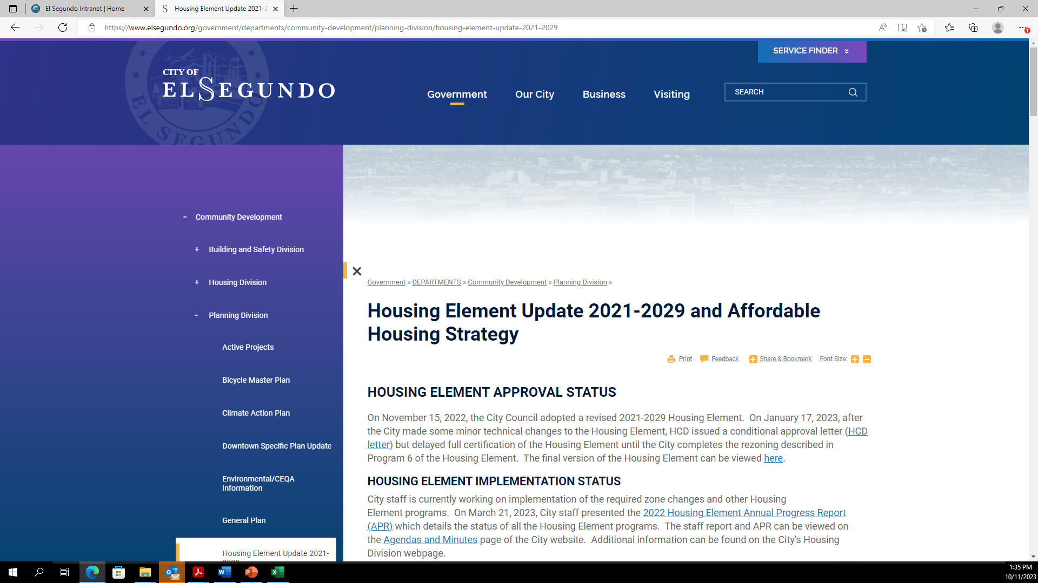
City Website and Resources
www.elsegundo.org/housing-element
Housing Element
Annual Progress Report (APR)
Email Updates
Video Links
Related Documents

Slide 15
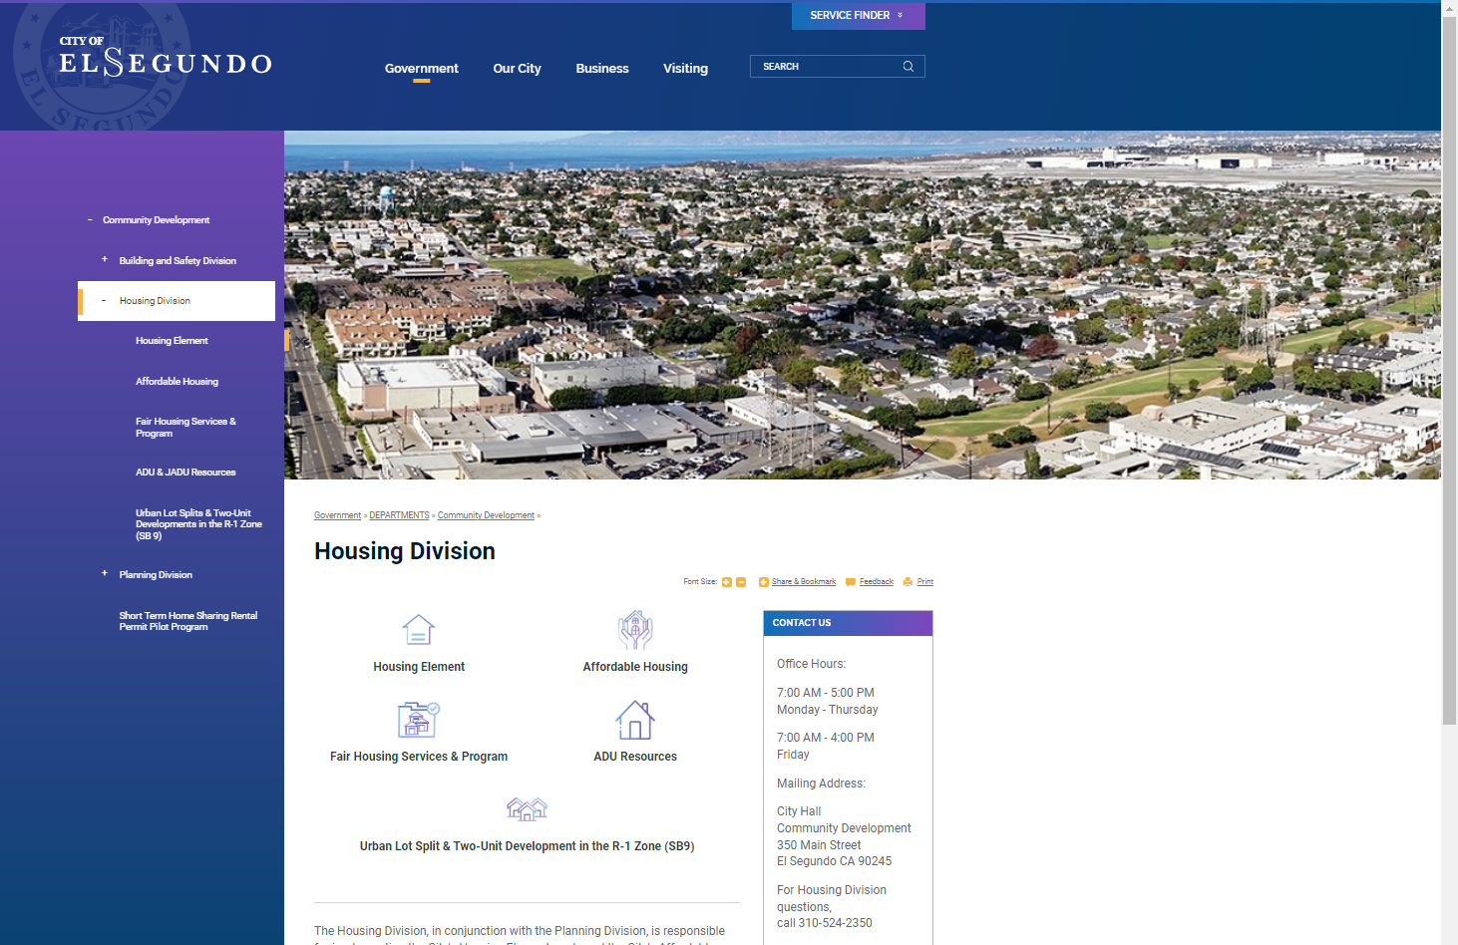
City Website and Resources
Housing Division webpage
Housing Element
Fair Housing Services (LA County)
Affordable Housing Resources
ADU Information and Resources
Notes:
.

Slide 16
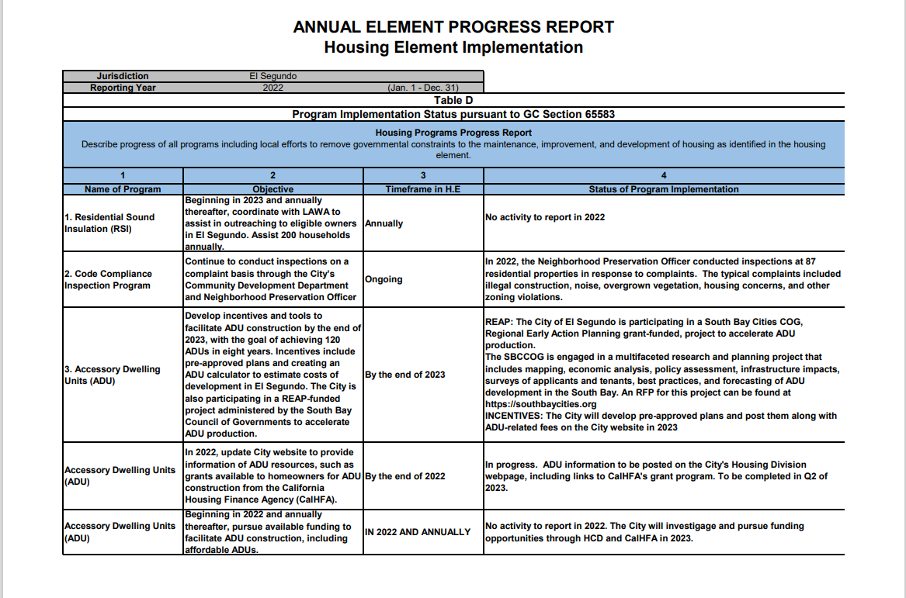
Annual Progress Report
Status on number of units
Market
Affordable
Activity and status on all programs and goals

Slide 17
Questions and Comments

Slide 18
HCD – affordable housing categories
Acutely low income: 0-15% of AMI
Extremely low income: 15-30% of AMI
Very low income: 30% to 50% of AMI
Lower income: 50% to 80% of AMI; the term may also be used to mean 0% to 80% of AMI
Moderate income: 80% to 120% of AMI
Notes:
AMI: local area median income
Affordable housing cost: for lower-income households is defined in State law as not more than 30 percent of gross household income with variations
Housing Cost: commonly includes rent or mortgage payments, utilities (gas, electricity, water, sewer, garbage, recycling, green waste), and property taxes and insurance on owner-occupied housing.
Income Limits | California Department of Housing and Community Development

Slide 19
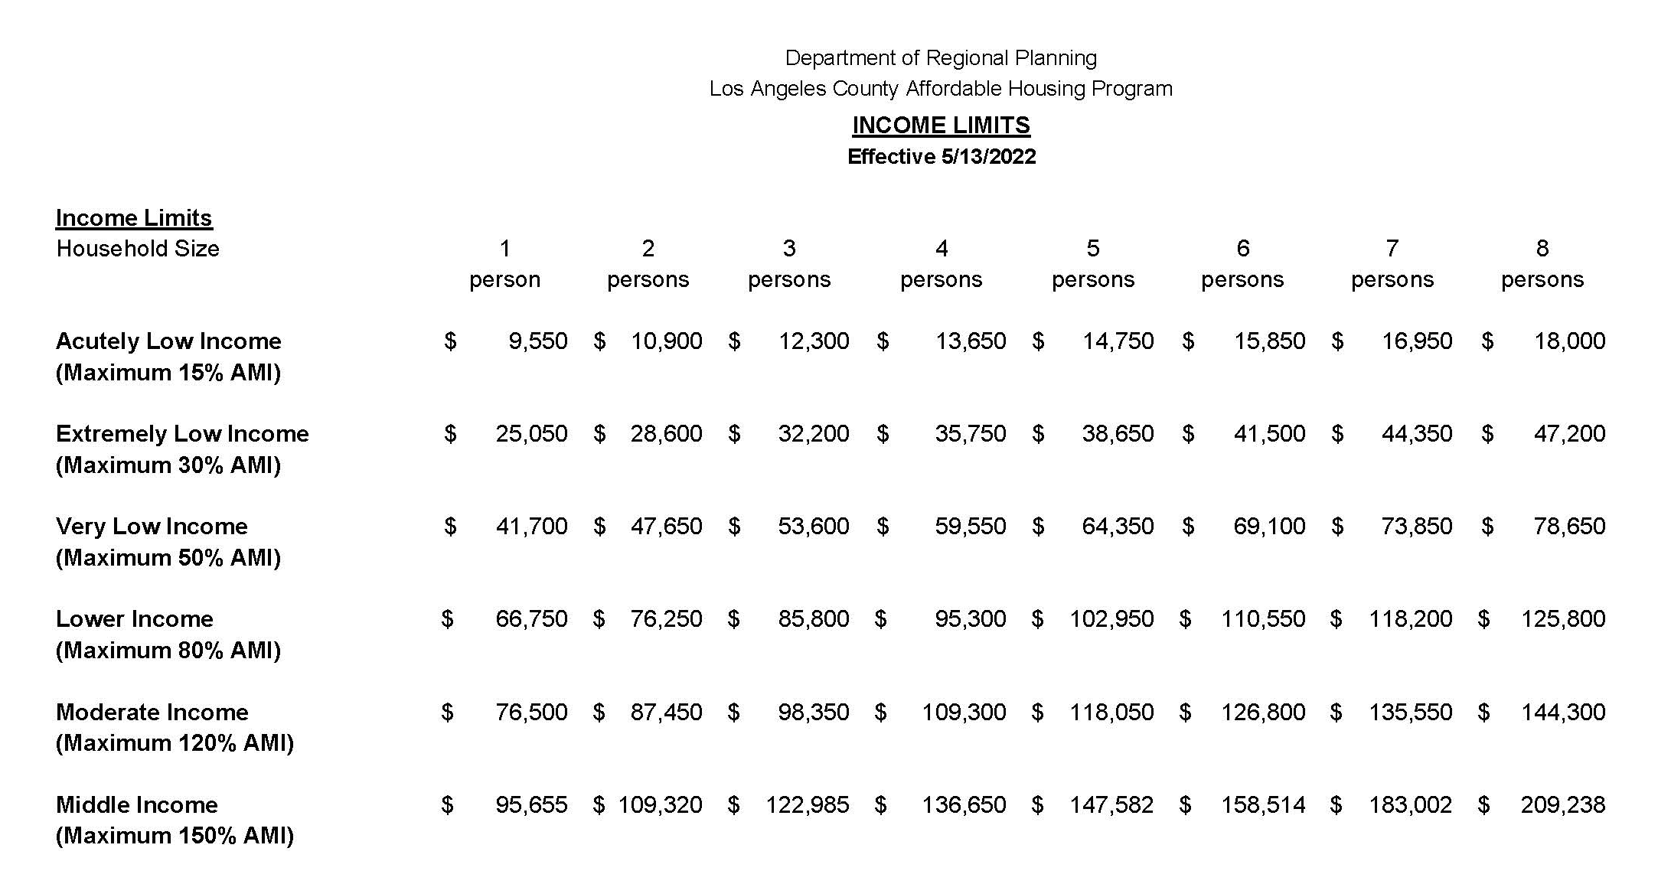
LA County 2022 Income limits

Slide 20
Affordable Housing Strategic Plan
10 policies, programs, and funding strategies
Priorities
Prioritize current residents or employees in the City for new affordable housing
Focus efforts to specific areas in the City
Downtown homes for young professionals
Local Trust Fund for Affordable Housing
Notes:
Update the code and require a local “live/work preference” in development agreements
Focus areas are: Smoky Hollow, West site of PCH, East Imperial Ave, and Downtown
Downtown. Work to attract young professionals (live work play)
Trust Fund. Provide matching funds to State funding on affordable housing projects

