Slide 1

EA-1289, SUB 20-03, and SPR 20-30
One-year Time Extension to VTPM No. 83129 and Associated Development Applications at:
650-700 N. Pacific Coast Highway and 737 Carl Jacobson Way

Slide 2
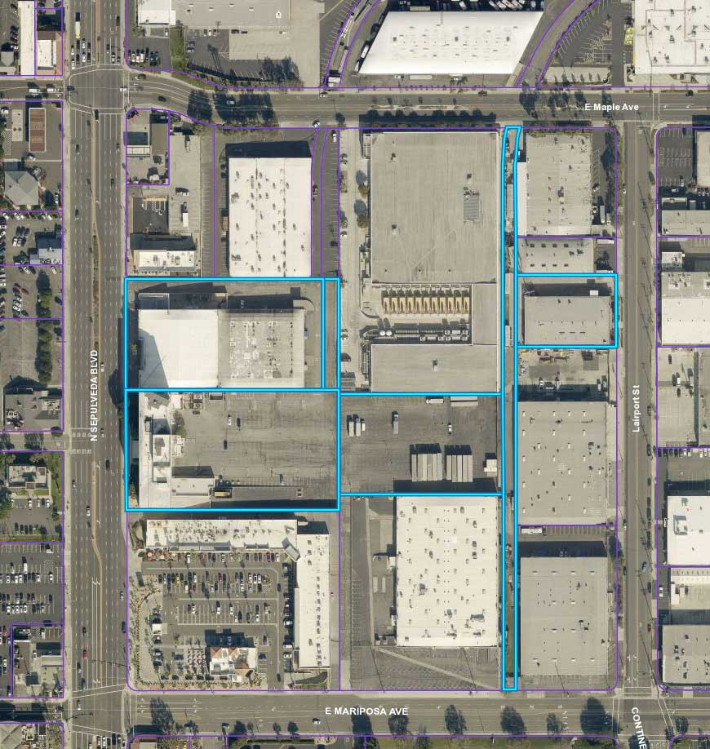
650 N. PCH: 8-story Office Building
700 N. PCH: 2-story Office Building
737 Carl Jacobson Way: 1-story Office Building
737
700
650

Slide 3
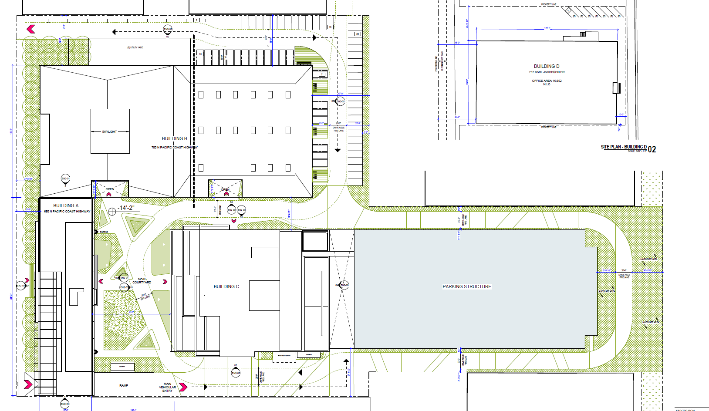

Slide 4
Background & Project Description:
The Map was due to expire on May 18, 2023.
A timely request for the extension was submitted.
No changes proposed to the Map or Development.
New expiration date, May 18, 2024.

Slide 5
In Summary
Findings can be made to approve the request, as no changes are proposed to the Map or Development.
Staff recommends the adoption of Resolution No. 2936.

