Slide 1

City Council Budget Study Session
August 5, 2020
8:00 AM
Notes:
Updated Jan. 9, 2017

Slide 2
AGENDA
Study Session Overview
Background Items
Proposed FY 2020-2021 Budget
Next Steps

Slide 3
Background Items
City Strategic Plan - July 22 Study Session Follow-up
Update on the Economy
FY 2019-20 Budget Update

Slide 4
FY 2020-2021 City Strategic Plan Follow-up
City Council’s Top Nine/Ten Priorities:
Obtain an “Age Friendly City” designation
Determine future of the Teen Center
Continue to advocate for El Segundo’s interests regarding LAX expansion
Notes:
Break into 4 slides

Slide 5
FY 2020-2021 City Strategic Plan Follow-up
City Council’s Top Nine/Ten Priorities (continued):
Consider guidelines for use of potential revenue from golf course lease
Identify further infrastructure and downtown improvements for Main Street
Attract senior living facilities to El Segundo
Notes:
Break into 4 slides

Slide 6
FY 2020-2021 City Strategic Plan Follow-up
City Council’s Top Nine/Ten Priorities (continued):
Identify areas within the community that are appropriate for housing
Conduct a study of repurposing City Hall
Develop a unique value proposition for attracting new businesses
Notes:
Break into 4 slides

Slide 7
FY 2020-2021 City Strategic Plan Follow-up
City Council’s Top Nine/Ten Priorities (continued):
Add New Priority:
Ensure that the City is positioned for post-COVID-19 recovery
Notes:
Break into 4 slides

Slide 8
FY 2020-2021 City Strategic Plan Follow-up
No changes to:
City Mission Statement
City Vision Statement
City Values & Culture Statement
Notes:
However we understand the desire to revamp these statements in the future

Slide 9
FY 2020-2021 City Strategic Plan Follow-up
Goal 1
Embrace diversity, equity, & inclusion; Enhance customer service, engagement, and communication
Revised Goal description only
Notes:
9

Slide 10
FY 2020-2021 City Strategic Plan Follow-up
Goal 2
Support community safety and preparedness
No change to Goal description
New Activity #5:
Complete COVID-19 emergency response analysis
Notes:
10

Slide 11
FY 2020-2021 City Strategic Plan Follow-up
Goal 3
Develop as a choice employer and workforce
No change
Notes:
11

Slide 12
FY 2020-2021 City Strategic Plan Follow-up
Goal 4
Develop and maintain quality infrastructure and technology
No change to Goal description
New Activity #10 (for Objective 4A):
Review the following environmental proposals:
Update Single-use Plastic Policy;
Establish Green Business Recognition Program;
Develop Green Construction Standards & Incentives;
Explore joining Clean Power Alliance; and
Expand water conservation efforts.
Notes:
12

Slide 13
FY 2020-2021 City Strategic Plan Follow-up
Goal 5
Champion economic development and fiscal sustainability
No change to Goal description
New Activity #13 (for Objective 5A):
Develop an El Segundo Gross Domestic Product (GDP) metric, and then incorporate into a Key Performance Indicator (KPI)
New Key Performance Indicators:
Track new building construction square footage
Track Annual El Segundo GDP
Notes:
13

Slide 14
Economic Overview
Unemployment
Inflation
Gross Domestic Product
Federal Interest Rate Projections
Notes:
JAN

Slide 19
FY 2019-2020 Budget Update
Scenario One – as presented to City Council on May 5, 2020
Virus peaks in May 2020 & Recovery slowly starts in July 2020
General Fund was projected to experience a $9.6 million (or 12%) FY 2019-2020 revenue reduction.
Notes:
To better understand the impacts of COVID-19 on the General Fund, and the necessary corrective steps to ensure that FY 2019-20 budget remains balanced by fiscal year-end, staff did a thorough review and analysis of both revenues and expenditures. Staff analyzed three different scenarios based on the timing of the peak of the virus and beginning of the economic recovery. Each scenario assumes a time separation of three months as follows:
Scenario One: Virus peaks in May 2020 & Recovery slowly starts in July 2020
The General Fund is projected to experience a $9.6 million (or 12%) revenue loss for the current FY.
Economic Recovery Scenario Two: FY 2019-2020 General Fund Budget Adjustments
If the State and/or Los Angeles County emergency orders are extended into June or July and/or the economic recovery doesn’t start until closer to October, then staff will return to City Council in late July with the recommendation to shift to Scenario Two budget reductions. For the General Fund, total revenue losses would approach $15,200,000 and trigger up to $5,600,000 in additional FY 2019-2020 Budget appropriation reductions (including a reduction of six more positions).
Economic Recovery Scenario Three: FY 2019-2020 General Fund Budget Adjustments
If the State and/or Los Angeles County emergency orders are extended through the end of fiscal year (through September 30, 2020) and/or the economic recovery doesn’t start until January 2021, then staff will return to City Council with the recommendation to shift to Scenario Three budget reductions. For the General Fund, this may involve up to another $900,000 in additional FY 2019-2020 Budget appropriation reductions and potentially more significant reductions in FY 2020-2021.

Slide 20
FY 2019-2020 Economic Recovery Scenario One model
No. | General Fund Category | FY 2019-20 Adopted Budget (10-01-2019) | FY 2019-2020 Revised Budget (05-05-2020) | $ Change | % Change
1 | Beg. Fund Balance (10/01/19) | $20,783,395 | $24,198,953 | $3,415,558 | 18%
2 | Revenues | 76,710,208 | 67,107,993 | (9,602,215) | (12%)
3 | Appropriations | (80,782,540) | (74,595,883) | (6,186,657) | (8%)
4 | Use of Reserves | 0 | 0 | 0 | -
5 | End. Fund Balance (9/30/20) | 16,711,063 | 16,711,063 | 0 | -
6 | Transfer-out Pension Trust | (1,559,000) | (1,559,000) | 0 | -
7 | Total Reserves at Year-end | $15,152,063 | $15,152,063 | $0 | -

Slide 21
FY 2019-2020 General fund revenues – 3rd Quarter
3rd Quarter = October 1, 2019 – June 30, 2020
No | Revenue Source | FY 2019-20 Revised Budget | FY 2019-20 Actual Thru 06/30/20 | % Recv’d | Prior Year Actual Thru 06/30/19
1 | Business License | $12,260,000 | $12,246,202 | 99% | $12,065,344
2 | Sales & Use Tax | 10,676,000 | 7,160,652 | 67% | 6,762,838
3 | Transient Occupancy Tax (T.O.T.) | 9,059,660 | 6,126,758 | 67% | 8,432,590
4 | Property Tax | 8,599,500 | 8,803,794 | 102% | 8,103,693
5 | Utility User’s Tax (UUT) | 5,992,062 | 4,632,503 | 77% | 5,310,020
6 | Tax Resolution (TRA) | 5,902,063 | 5,902,063 | 100% | 6,171,627
7 | Charges for Services | 3,798,845 | 3,070,930 | 81% | 3,870,028
8 | Franchise Tax | 3,200,000 | 3,212,104 | 100% | 2,568,833
9 | Other Revenues | 3,018,995 | 1,606,663 | 53% | 2,442,371
10 | Intergov. Revenues | 1,926,490 | 1,923,848 | 99% | 1,773,917
11 | License & Permits | 1,538,358 | 1,514,850 | 98% | 1,670,804
12 | Interest & Rentals | 804,000 | 546,272 | 68% | 1,112,588
13 | Fines & Forfeitures | 192,020 | 193,951 | 101% | 418,142
14 | Transfers In | 140,000 | 140,000 | 100% | -
15 | Total | $67,107,993 | $57,080,590 | 85% | $60,682,795
Notes:
This table represents the total GF revenue collected through the 1st six months of the current FY, compared to the 1st six months of the prior FY. The revenues are trending very similar, with some key sources, such as T.O.T., trending higher in the current FY.
FY 2018-19 ended with $80.2M in GF revenue.
Transient Occupancy Tax
$9,059,660
$6,126,758
67%
$8,412,590

Slide 22
FY 2019-2020 General Fund Expenditures – 3rd Quarter
No | Department | FY 2019-2020 Year-end Estimate | FY 2019-20 Actual Thru 06/30/20 | % Expensed | Prior Year Actual Thru 06/30/19
1 | Police | $21,780,602 | $16,470,454 | 76% | $16,436,381
2 | Fire | 15,994,908 | 12,200,541 | 76% | 12,094,146
3 | Public Works | 7,612,426 | 4,715,756 | 62% | 4,910,618
4 | Recreation & Parks | 6,759,322 | 3,679,227 | 54% | 4,045,660
5 | Non-department | 5,616,639 | 4,653,963 | 83% | 4,021,146
6 | Planning & Building Safety | 3,001,130 | 1,901,877 | 63% | 1,858,972
7 | Information Technology | 2,592,636 | 1,829,587 | 71% | 1,534,583
8 | City Manager | 2,374,470 | 1,461,328 | 62% | 1,498,444
9 | Finance | 2,181,892 | 1,494,789 | 69% | 1,473,678
10 | Library | 2,394,131 | 1,648,640 | 69% | 1,734,663
12 | Human Resources | 1,163,432 | 750,157 | 64% | 656,525
13 | City Attorney | 585,450 | 372,515 | 64% | 365,698
14 | City Clerk | 640,038 | 339,660 | 53% | 327,372
15 | City Treasurer | 341,375 | 242,315 | 71% | 221,409
16 | City Council | 308,432 | 207,431 | 67% | 188,490
17 | Total Operating Expenditures | 73,346,883 | 51,968,240 | 71% | 51,367,785
18 | Transfers out | 1,249,000 | 1,249,000 | 100% | 3,350,000
19 | Total General Fund Expenditures | $74,595,883 | $53,217,240 | 71% | 54,717,785
3rd Quarter = October 1, 2019 – June 30, 2020
Notes:
CLASSIFICATION FY 2011/12 FY 2012/13 FY 2013/14 FY 2014/15 FY 2015/16 FY 2016/17
Transient Occupancy Tax 4,735,585 5,156,080 5,964,403 5,423,972 7,597,007 9,600,000
UUT = $7.2M budgeted in FY 2016-17, reduced by $410k for the mid-year presentation. Trending to come in at $6.2M for year-end. Peaked at $9M in FY 13-14 and have been declining since.
Total operational budget represents a $1.4M increase from the prior year (less transfers out)
Most departments reflect the status quo. Large variances are in PD ~$700k (due to POA & PSSEA new MOUs, escalating pension costs), Fire = $200k due to escalating pension costs, $250k for IS (IS director budgeted only 50% last year, increase in software maintenance costs ~$50K due to implementation of new Tech, increase in training budget), $130k for Finance (Finance Manager budgeted for full year, step increases, and +$10k for travel & training), City Clerk $100k for elections,
General Fund Revenue Budget
Increase of $4,608,429 over the FY 2015-16 adopted budget
Transient Occupancy Tax – $3,490,600 increase
Franchise Tax - $750,000 increase
Tax Resolution Agreement (TRA) - $750,000 increase
Other Revenue - $610,431 increase (one-time developer fees)
Property Tax – $394,693 increase
Business License Tax - $214,520 increase
Utility Users’ Tax – $888,000 decrease

Slide 23
FY 2019-2020 Water Fund – 3rd Quarter
Revenues
Expenses:
3rd Quarter = October 1, 2019 – June 30, 2020
FY 2019-20 Budget | $31,281,260
FY 2019-20 3rd Quarter | $18,318,581
FY 2018-19 3rd Quarter | $21,967,568
FY 2019-20 Budget | $29,812,873
FY 2019-20 3rd Quarter | $17,462,547
FY 2018-19 3rd Quarter | $20,963,129
Notes:
Water Utility Enterprise Fund
3rd quarter difference of $3.65M: timing of billing to Chevron for recycled water sales, timing of billing to residential and commercial properties for potable water sales, and a reduction of interest income earned on fund balance
3rd quarter difference of $3.5M: $1.3M less in CIP for FY 2019-20 and timing of West Basin bill for the purchase of water ($2.2M)

Slide 24
FY 2019-2020 Wastewater Fund – 3rd Quarter
Revenues
Expenses
3rd Quarter = October 1, 2019 – June 30, 2020
FY 2019-20 Budget | $3,886,200
FY 2019-20 3rd Quarter | $2,894,708
FY 2018-19 3rd Quarter | $3,455,095
FY 2019-20 Budget | $5,306,636
FY 2019-20 3rd Quarter | $2,725,533
FY 2018-19 3rd Quarter | $3,097,594
Notes:
3rd quarter difference of $560K: $375k in developer fees (D.R. Horton) received in FY 2018-19, $125k increased interest income earned on fund balance, and timing of billings for $60k.
3rd quarter difference of $370k: additional CIP completed in FY 2018-19

Slide 25
FY 2019-2020 Golf Fund – 3rd Quarter
Revenues
Expenses
3rd Quarter = October 1, 2019 – June 30, 2020
FY 2019-20 Budget | $1,450,667
FY 2019-20 3rd Quarter | $ 882,200
FY 2018-19 3rd Quarter | $1,127,272
FY 2019-20 Budget | $1,417,800
FY 2019-20 3rd Quarter | $ 948,307
FY 2018-19 3rd Quarter | $1,130,921
Notes:
The Golf Course Fund is currently at 28%
Overall revenue is lower due to the golf course operations being shuttered in March-May due to COVID-19, as well as the food & beverage and pro shop operations continue to be closed
Overall expenses are less than budgeted due to the golf course operations being shuttered in March-May due to COVID-19, as well as the food & beverage and pro shop operations continue to be closed

Slide 26
Fiscal Year Change
Shift from October 1 – September 30 to July 1 – June 30
FY 2020-21 Budget will be 9 months: Oct. 1, 2020 – June 30, 2021
FY 2021-2022 Budget will be 12 months: July 1, 2021 to June 30, 2022

Slide 27
Restructuring of City Departments (continued)
City Manager’s Office
Oversight of Departments

Slide 28
Restructuring of City Departments (continued)
Deputy City Manager
City Clerk’s Office
Development Services
Fire
Human Resources
Police
Note: Actual distribution of departments may change
Deputy City Manager/
Finance Director
Community Services
Finance
Information Technology
Public Works

Slide 29
Restructuring of City Departments (continued)
Community Services Department
Merger of Recreation & Parks and Library
Reorganization within the Library

Slide 30
Restructuring of City Departments (continued)
Development Services Department
Rename from Planning & Building Safety Department
Establish a Housing Division
Affordable Housing
Senior Housing
Park Vista Senior Center

Slide 31
Restructuring of City Departments
Finance Department
Inclusion of City Treasurer’s Office
Operational efficiencies
Consolidation of Risk Management function
New Risk Manager position
Workers’ Compensation Fund (75%)
General Liability Fund (25%)

Slide 32
Restructuring of City Departments (continued)
Information Technology Services Department
Rename from Information Services Department

Slide 33
Restructuring of City Departments (continued)
Public Works Department
Include Parks/Landscaping Maintenance Services

Slide 34
FY 2020-2021 Budget Scenario Two
Scenario Two – as presented to City Council on May 5, 2020
Virus peaks in August 2020 & Recovery starts in December 2020
General Fund is projected to experience a $12 million (or 15%) FY 2020-2021 revenue reduction.*
*May 5, 2020 Scenario Two anticipated a $15.2 million or 20% reduction

Slide 35
Estimated FY 2020-2021 Revenues (all Funds)
No. | Fund | FY 2019-20 | % of Total Budget | FY 2020-21 | % of Total Budget
1 | General Fund | $76,710,208 | 60.9% | $58,328,024 | 62.2%
2 | Water Fund | 31,281,360 | 24.8% | 23,417,500 | 25.0%
3 | Wastewater Fund | 3,886,200 | 3.1% | 3,110,000 | 3.4%
4 | Worker's Comp Fund | 2,975,035 | 2.4% | 2,258,193 | 2.4%
5 | CIP Fund | 2,749,000 | 2.2% | 1,350,000 | 1.4%
6 | Equip. Rep. Fund | 2,089,441 | 1.7% | 1,064,200 | 1.1%
7 | General Liability Fund | 1,914,179 | 1.5% | 1,400,000 | 1.5%
8 | Transportation Funds | 1,595,064 | 1.3% | 1,228,835 | 1.3%
9 | Golf Fund | 1,450,667 | 1.2% | 747,500 | 0.8%
10 | Other Special Rev. Funds | 512,380 | 0.4% | 378,500 | 0.4%
11 | Federal & State Grants | 473,748 | 0.3% | 219,000 | 0.2%
12 | Debt Service Fund | 183,600 | 0.1% | 137,000 | 0.1%
13 | Public Safety Sp. Rev. Funds | 159,712 | 0.1% | 162,335 | 0.2%
14 | Senior Housing Fund | 2,714 | 0.0% | 10,000 | 0.0%
 |  | $125,983,308 | 100.0% | $93,811,087 | 100.0%
Notes:
Speaking Points:
The total proposed appropriations for all funds for FY 2019-20 is $137,748,721
The three top appropriation categories consume 94.2% of the total Citywide budget:
The General Fund consumes the largest portion of the total Citywide Budget at 58.6% ($80,782,540).
Enterprise Funds combined (No. 2, 4, 10 & 14) consume the second largest portion of the total Citywide Budget at 26.5%, with the individual operations of Water, Wastewater, Golf, and the new Solid Waste Fund included.
Internal Service Funds (No. 3, 5, & 8) total 9.1% of the total Citywide budget and include the Equipment Replacement Fund, Worker’s Compensation Fund, and the General Liability Fund.

Slide 36
Proposed FY 2020-2021 Appropriations (all Funds)
No. | Fund Name | FY 2019-20 Adopted | % of Total | FY 2020-21 Proposed | % of Total
1 | General Fund | $80,782,540 | 58.6% | $58,128,024 | 64.5%
2 | Water Fund | 29,622,670 | 21.5% | 18,285,000 | 20.3%
3 | Equip. Rep. Fund | 7,849,761 | 5.7% | 1,364,000 | 1.5%
4 | Wastewater Fund | 5,235,334 | 3.8% | 3,110,000 | 3.5%
5 | Worker's Comp Fund | 2,934,272 | 2.1% | 2,975,000 | 3.3%
6 | CIP Fund | 2,749,000 | 2.0% | 1,350,000 | 1.5%
7 | Transportation Funds | 2,284,527 | 1.7% | 1,228,835 | 1.4%
8 | General Liability Fund | 1,783,333 | 1.3% | 1,900,000 | 2.1%
9 | Public Safety Sp. Rev. Funds | 1,661,565 | 1.2% | 140,750 | 0.2%
10 | Golf Fund | 1,417,800 | 1.0% | 847,500 | 0.9%
11 | Other Special Rev. Funds | 578,806 | 0.4% | 378,500 | 0.4%
12 | Debt Service Fund | 545,000 | 0.4% | 137,000 | 0.2%
13 | Solid Waste Fund | 230,000 | 0.2% | - | 0.0%
14 | Senior Housing Fund | 74,113 | 0.1% | 10,000 | 0.0%
 |  | $137,748,721 | 100.0% | $90,073,809 | 100.0%
Notes:
Speaking Points:
The total proposed appropriations for all funds for FY 2019-20 is $137,748,721
The three top appropriation categories consume 94.2% of the total Citywide budget:
The General Fund consumes the largest portion of the total Citywide Budget at 58.6% ($80,782,540).
Enterprise Funds combined (No. 2, 4, 10 & 14) consume the second largest portion of the total Citywide Budget at 26.5%, with the individual operations of Water, Wastewater, Golf, and the new Solid Waste Fund included.
Internal Service Funds (No. 3, 5, & 8) total 9.1% of the total Citywide budget and include the Equipment Replacement Fund, Worker’s Compensation Fund, and the General Liability Fund.

Slide 37
FY 2020-2021 General Fund Revenues Estimated by Source
No. | Source | Revenue | % of Total
1 | Business License Tax | $10,489,360 | 18%
2 | Property Tax | 9,145,025 | 16%
3 | Sales Tax | 8,573,683 | 14%
4 | Transient Occupancy Tax (TOT) | 7,524,570 | 13%
5 | Tax Resolution Agreement | 6,000,000 | 10%
6 | Utility Users Tax (UUT) | 4,494,047 | 8%
7 | Charges for Service | 3,415,836 | 6%
8 | Franchise Tax | 2,250,000 | 4%
9 | Intergovernmental Revenues | 1,942,770 | 3%
10 | Other Revenues | 2,416,964 | 3%
11 | License & Permits | 1,153,769 | 2%
12 | Interest & Rentals | 603,000 | 1%
13 | Fines & Forfeitures | 294,000 | 1%
14 | Transfers -in | 25,000 | 0%
 | Total | $58,328,024 | 100%

Slide 38
FY 2020-21 Revenue Assumptions
T.O.T. assumes a 20%-25% occupancy rate through December 2020 & slowly improving beginning in January 2021
Business License Tax assumes an aggregate 16% reduction in workforce for businesses within El Segundo
Notes:
CalPERS pension costs continue to rise
Public Safety Rates: 46.6% (FY 15-16), 49.97% (16-17), 55.03% (17-18), 61.2% (18-19), 67.6% (19-20), 75.5% (20-21), & 80.1% (21-22)
Misc. Rates: 17.73% (FY 15-16), 19.07% (16-17), 20.6% (17-18), 23.5% (18-19), 26.4% (19-20), 29.6% (20-21), & 31.6% (21-22)
Rates stay high through FY 2030 and then slowly ramp back down through 2045

Slide 39
FY 2020-21 Revenue Assumptions
Sales Tax is down ~12% from pre-COVID-19 trend
UUT is down ~35% from pre-COVID-19 trend
Notes:
CalPERS pension costs continue to rise
Public Safety Rates: 46.6% (FY 15-16), 49.97% (16-17), 55.03% (17-18), 61.2% (18-19), 67.6% (19-20), 75.5% (20-21), & 80.1% (21-22)
Misc. Rates: 17.73% (FY 15-16), 19.07% (16-17), 20.6% (17-18), 23.5% (18-19), 26.4% (19-20), 29.6% (20-21), & 31.6% (21-22)
Rates stay high through FY 2030 and then slowly ramp back down through 2045

Slide 40
FY 2020-2021 Proposed General Fund Appropriations by Department
No. | Department | Appropriations
1 | Police | $18,027,139
2 | Fire | 13,296,783
3 | Community Services | 6,831,657
4 | Public Works | 5,347,923
5 | Non-department | 3,721,450
6 | Development Services | 2,537,394
7 | Information Technology Services | 2,234,087
8 | City Manager | 1,914,089
9 | Finance | 1,885,575
10 | Human Resources | 917,405
11 | City Attorney | 561,950
12 | City Clerk | 421,157
13 | City Council | 260,903
14 | Total Operating Budget | 58,112,213
15 | Transfers out to CIP | 1,200,000
16 | Total General Fund Expenditures | $59,312,213
Notes:
CLASSIFICATION FY 2011/12 FY 2012/13 FY 2013/14 FY 2014/15 FY 2015/16 FY 2016/17
Transient Occupancy Tax 4,735,585 5,156,080 5,964,403 5,423,972 7,597,007 9,600,000
UUT = $7.2M budgeted in FY 2016-17, reduced by $410k for the mid-year presentation. Trending to come in at $6.2M for year-end. Peaked at $9M in FY 13-14 and have been declining since.
Total operational budget represents a $1.4M increase from the prior year (less transfers out)
Most departments reflect the status quo. Large variances are in PD ~$700k (due to POA & PSSEA new MOUs, escalating pension costs), Fire = $200k due to escalating pension costs, $250k for IS (IS director budgeted only 50% last year, increase in software maintenance costs ~$50K due to implementation of new Tech, increase in training budget), $130k for Finance (Finance Manager budgeted for full year, step increases, and +$10k for travel & training), City Clerk $100k for elections,
General Fund Revenue Budget
Increase of $4,608,429 over the FY 2015-16 adopted budget
Transient Occupancy Tax – $3,490,600 increase
Franchise Tax - $750,000 increase
Tax Resolution Agreement (TRA) - $750,000 increase
Other Revenue - $610,431 increase (one-time developer fees)
Property Tax – $394,693 increase
Business License Tax - $214,520 increase
Utility Users’ Tax – $888,000 decrease

Slide 41
FY 2020-21 Budget Appropriation Assumptions
Personnel Costs
Salary & benefit adjustments based on multi-year MOUs
Minimum hourly wage effective each January 1:
2020 = $13
2021 = $14
2022 = $15
Notes:
CalPERS pension costs continue to rise
Public Safety Rates: 46.6% (FY 15-16), 49.97% (16-17), 55.03% (17-18), 61.2% (18-19), 67.6% (19-20), 75.5% (20-21), & 80.1% (21-22)
Misc. Rates: 17.73% (FY 15-16), 19.07% (16-17), 20.6% (17-18), 23.5% (18-19), 26.4% (19-20), 29.6% (20-21), & 31.6% (21-22)
Rates stay high through FY 2030 and then slowly ramp back down through 2045

Slide 42
FY 2020-21 Budget Appropriation Assumptions
Personnel Costs
City will continue to implement the Bartel Plan to reduce unfunded CalPERS pension liabilities over 20 years
Public Safety Rate: 71.4% for FY 2019-20 increasing to 99.5% by FY 2029-30
Misc. Rate: 26.7% for FY 2018-19 increasing to 33.8% by FY 2029-30
Rates begin to decrease by FY 2030-31 to normalize at an estimated 18% for Public Safety & 9% for Miscellaneous plans by FY 2039-40
Potential to reduce future costs (Council Pension Sub-Committee)
Notes:
CalPERS pension costs continue to rise
Public Safety Rates: 46.6% (FY 15-16), 49.97% (16-17), 55.03% (17-18), 61.2% (18-19), 67.6% (19-20), 75.5% (20-21), & 80.1% (21-22)
Misc. Rates: 17.73% (FY 15-16), 19.07% (16-17), 20.6% (17-18), 23.5% (18-19), 26.4% (19-20), 29.6% (20-21), & 31.6% (21-22)
Rates stay high through FY 2030 and then slowly ramp back down through 2045

Slide 43
FY 2019-2020 Vacant Positions
35 vacant full-time positions (August 2020):
Public Works – 9
Police – 8
Community Services – 5
Fire – 3
Information Technology – 3
Finance – 3
Development Services – 2
City Manager - 1
Human Resources – 1

Slide 44
Proposed FY 2020-2021 Frozen Full-Time Positions
Department | Authorized Positions | Vacant Positions | Frozen Positions for FY 2020-21
Police | 82 | 8 | 6
Fire | 52 | 3 | 2
Public Works | 48 | 9 | 5
Community Services | 33 | 5 | 4
Development Services | 17 | 2 | 1
Finance | 3 | 1 | 1
Human Resources | 5 | 1 | 1
Other Departments | 43 | 6 | 0
Total | 283 | 35 (12.4%) | 20 (7.1%)
Note: Excludes part-time positions

Slide 45
FY 2020-21 Budget Appropriation Assumptions
Operating & Maintenance (O&M) Budgets
Departmental O&M reduced by approximately 15%
Equipment replacement charges funded at 50% for FY 2020-2021; returning to 100% in FY 2021-22
No funding for new technology or infrastructure projects
Notes:
CalPERS pension costs continue to rise
Public Safety Rates: 46.6% (FY 15-16), 49.97% (16-17), 55.03% (17-18), 61.2% (18-19), 67.6% (19-20), 75.5% (20-21), & 80.1% (21-22)
Misc. Rates: 17.73% (FY 15-16), 19.07% (16-17), 20.6% (17-18), 23.5% (18-19), 26.4% (19-20), 29.6% (20-21), & 31.6% (21-22)
Rates stay high through FY 2030 and then slowly ramp back down through 2045

Slide 46
General Fund Multi-Year Forecast
Notes:
Revenue forecast for FY 2020-2021 assumes continued COVID-19 impacts to the local economy and after assumes conservative growth for each year
Appropriations forecast for FY 2020-2021 assumes continued COVID-19 impacts to City services and after assumes 100% expenditures for each year
Notes:
FY 2018-19 included $3.1M in transfers out to the CIP fund for capital and technology related projects, as well as one-time payments to the pension trust of $1M and payments towards PERS unfunded liabilities in the amount of $1.5M.
The GF expenditures are 80% personnel and 20% O&M. The expenditure line assumes a vacancy rate of 5.5% or 13 vacant FTEs for a savings of ~$2.3M. This assumes 50% public safety and 50% Misc. employees. The City has been consistently running a vacancy rate between 12%-15% over the past 3 years. A average attrition rate for most fully staffed municipalities is 3%-5%. Even with the strong efforts of the Human Resources Department to recruit for vacant positions, El Segundo has a mature workforce resulting in higher than average attrition as a result of retirements. Using a 5% vacancy rate is a conservative approach. The City will need to remain diligent on controlling the expenditures and reevaluating both program service levels and staffing levels in subsequent budget years.
The revenue line does not make any assumptions on any new fees, taxes, or lease revenues.
46

Slide 47
General Fund Multi-Year Forecast
Fiscal Year (FY) | Revenues | Appropriations | Fund Balance | GFOA Minimum 16.66% reserve
2018-19 | $80,014,542 | $78,056,312 | $22,298,953 | $12,956,700
2019-20 | 67,107,993 | 74,595,883 | 16,811,063 | 12,432,150
2020-21 | 58,328,024 | 59,462,213 | 15,676,874 | 9,909,972
2021-22 | 77,036,780 | 80,089,122 | 12,624,532 | 13,347,653
2022-23 | 78,622,452 | 82,945,246 | 8,301,738 | 13,823,655
2023-24 | 80,220,799 | 85,921,209 | 2,601,328 | 14,319,629
2024-25 | $81,859,887 | $88,100,604 | -$3,639,389 | $14,682,847
Not
Notes:
Revenue forecast for FY 2020-2021 assumes continued COVID-19 impacts to the local economy and after assumes conservative growth for each year
Appropriations forecast for FY 2020-2021 assumes continued COVID-19 impacts to City services and after assumes 100% expenditures for each year

Slide 48

New Budget Requests

Slide 49
Cultural Development Fund Proposed Budget
Arts & Cultural Commission budget recommendations

Slide 50
FY 2020-2021 Cultural Development Fund
Public Art
Gateway Project - $150,000
Library Park Activation - $50,000
Programming
Library - $25,000
Recreation & Parks - $25,000
Community Grants
Non-profit Cultural Institutions - $150,000
Artistic Programming - $30,000
Urban Placemaking/Parklets - $30,000
Administration – $15,000
Total Request = $475,000 (Fund Balance = $486,850)
Notes:
*Current Balance: $486,850
*DEI Emphasis for FY 20-21

Slide 51
Information Technology FY 2020-2021 Initiatives
IT Strategic Plan Update
Development Permitting System
Network Infrastructure Upgrade
Agenda Management System
City-wide Security Cameras
Start ERP (Eden) evaluation
City Council Chamber AV upgrade
Smoky Hollow ISP solutions evaluation
Facilities Work Order System evaluation

Slide 52
Capital Improvements Program
.
53

Slide 53
FY 2019-2020 CIP Projects
Total projects (year one of three-year plan) = $9,880,000
Projects completed or near completed = $4,720,000
Projects in-progress = $2,750,000
Deferred projects (May 5, 2020) = $1,410,000
$1,000,000 reserved for Plunge
Notes:
Approved a 3-year

Slide 54
FY 2019-2020 Projects
Project Completed or Near Completed - $4,720,000
Walnut Ave. Drainage and Street
Clubhouse Ductwork
Washington Park Playground
McCarthy Court Street
Fiber Vault Lids Replacement
Annual Pavement Rehabilitation
CDBG ADA Parking Facilities Restriping
El Segundo Blvd. Parking Pilot
Cedar Street Water Main Replacement
Others

Slide 55
FY 2019-2020 CIP Projects
Projects In-Progress - $2,750,000
Grand Ave. water main replacement - $1,200,000 (Water Fund)
Park Place Design - $600,000 (Measure R Fund)
Annual Roadway Rehabilitation - $500,000 (Transportation Funds)
Annual sidewalk Improvement Program - $250,000 (Gas Tax Fund)
Annual Wastewater infrastructure replacement - $150,000 (Wastewater Fund)
ADA sidewalk ramp improvements - $50,000 (CDBG Fund)

Slide 56
FY 2019-2020 CIP Projects
Deferred Projects - $1,410,000
Recreation Park Projects
(Restrooms, Skate Park, Teen Center) - $800,000 ($750K GF & $50K Dev Funds)
City Hall Windows (health & safety/energy efficiency) - $450,000 (Gen Fund)
Memory Row Fitness Trail - $100,000 (Dev Funds)
Park Vista Senior Center Plumbing Design - $60,000 (Senior Housing Fund)

Slide 57
Proposed FY 2020-2021 CIP Projects
No new projects added to Three-Year CIP
Fund FY 2019-2020 Deferred Projects:
Recreation Park Projects
(Restrooms, Skate Park, Teen Center) - $800,000 ($750,000 GF & $50,000 Dev Funds)
City Hall Windows (health & safety/energy efficiency) - $450,000 (Gen Fund)
Memory Row Fitness Trail - $100,000 (Dev Funds)
Park Vista Senior Center Plumbing Design - $60,000 (Senior Housing Fund)
Several Facilities Condition Assessment projects originally scheduled for FY 2020-2021 will be deferred until FY 2021-2022

Slide 58
Estimated FY 2020 – 2021 Fund Balance
GENERAL FUND
Estimated Revenues | $58,328,024
Proposed Appropriations (without CIP) | (58,112,213)
Difference | 215,811
Proposed CIP Projects | (1,200,000)
Difference | (984,189)
Use of Economic Uncertainty Reserve* | 984,189
Estimated Ending Unassigned Fund Balance (June 30, 2021) | 13,152,063
20% Reserve (9-month budget) | 11,892,442
20% Reserve (12-month budget) | $15,400,000
*Economic Uncertainty Reserve will temporarily decrease from $2,000,000 to $1,015,811. The difference ($984,189) will be restored as the economy and revenue improves.

Slide 59
Proposed FY 2020-21 Reserves
General Fund: Retain 20% reserve
Economic Uncertainty Reserve: Temporary decrease from $2,000,000 to $1,015,811 with goal to restore
Worker’s Comp Fund: $7,100,000 (~70% funded)
General Liability Fund: $1,000,000 (actuary)
Notes:
Pension trust balance was $2.5M during last year’s strategic planning
OPEB trust was at $24M during lest year’s strategic planning
59

Slide 60
Proposed FY 2020-21 Trust Balances
Pension Trust: $4.3M (June 30, 2020)
No additional funding proposed for FY 2020-21
OPEB Trust: $26.1M (June 30, 2020)
~40% funded
Full funding anticipated by 2030
No additional funding proposed for FY 2020-21
Notes:
Pension trust balance was $2.5M during last year’s strategic planning
OPEB trust was at $24M during lest year’s strategic planning
60

Slide 61
FY 2020-2021 Budget Scenario Three
Scenario Three – as presented to City Council on May 5, 2020
Virus peaks in December 2020 & Recovery starts in January 2021
General Fund is projected to experience a ~20% revenue reduction.*
*May 5, 2020 Scenario Three anticipated a $16.1 million or 20% reduction

Slide 62
Budget Balancing Tools (if Scenario Three)
Review Existing Labor Contracts
Use of Furloughs (including winter holidays furlough)
Voluntary Reduction in Hours
Further Position Reductions
Increased use of private contracts/privatization of services
Regionalization of Services
Additional “Pension Reform” Options
Across-the-board Appropriation Reductions
Notes:
In preparation for the FY 2020-21 budget process, staff will look at all options available to the City in order to develop a comprehensive balanced budget.
Some of the budget balancing options will be:
Review existing labor contracts
Use of furloughs (including winter holidays furlough)
Voluntary reduction in hours
Further position reductions
Increased use of private contracts/privatization of services
Regionalization of services
Additional “Pension Reform” options
Across-the-board appropriation cuts

Slide 63
Budget Balancing Tools (if Scenario Three)(CONTINUED)
Continued Deferred Maintenance
Service Reductions
Use of General Fund Reserves
Use of Economic Uncertainty Reserves
Revenue Enhancements
Early Retirement Incentives
Other items (TBD)
Notes:
Continued deferred maintenance
Service Reductions
Use of General Fund Reserves
Use of Economic Uncertainty Reserves
Revenue enhancements
Citywide reorganization to achieve a more efficient operational structure
Other items (TBD)

Slide 64
Next Steps
Water and Wastewater Funds Financial Plan – August 18, 2020
City-wide Fee Resolution – September 1, 2020
Proposed Budget Public Hearing & Adoption – September 15, 2020
FY 2020-2021 Commences – October 1, 2020
Begin preparation of FY 2021-2022 Budget – December 2020
Notes:
Pension trust balance was $2.5M during last year’s strategic planning
OPEB trust was at $24M during lest year’s strategic planning
64

Slide 65
Next Steps (continued)
Long-term Financial Strategic Plan
Twenty-year plan being developed by a consultant
City Council Pension Sub-Committee meetings to discuss pension and OPEB funding options
Municipal (Financial) Advisor retained
Notes:
Pension trust balance was $2.5M during last year’s strategic planning
OPEB trust was at $24M during lest year’s strategic planning
65

Slide 66
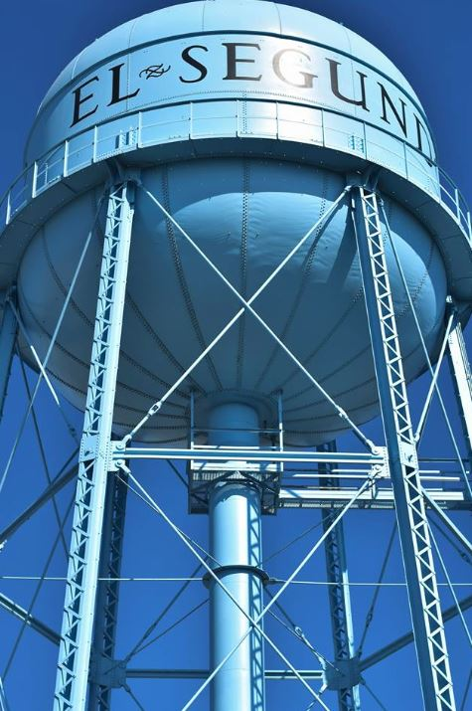
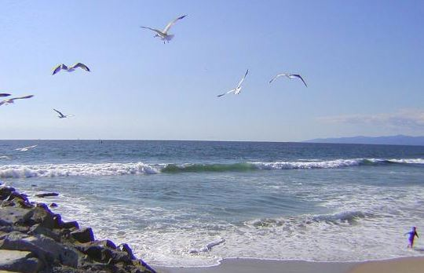
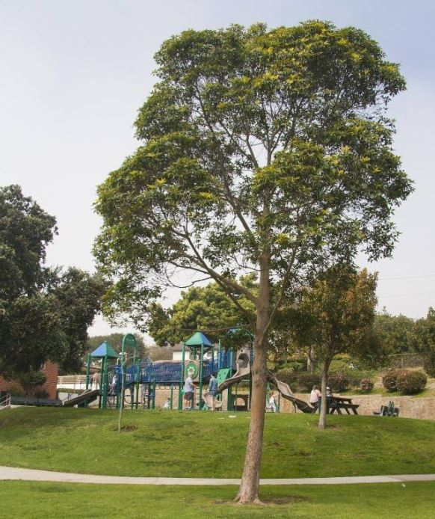
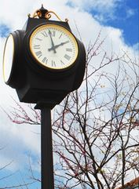
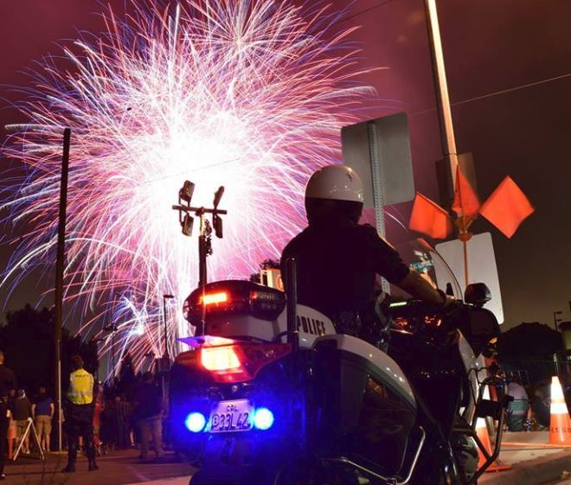
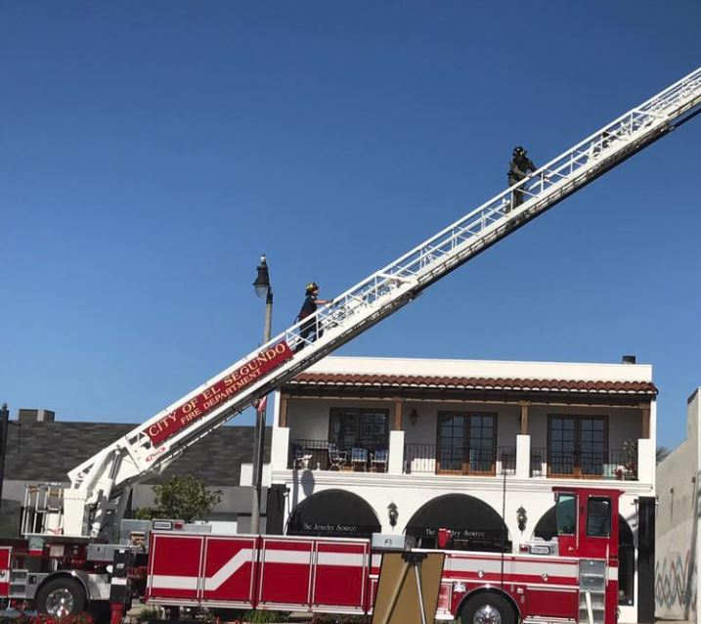
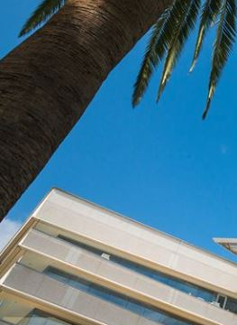
Wrap-up & Questions

