Slide 1





El Segundo I Vision 2050
General Plan Land Use Element Update
July 2, 2025

Slide 2
General Plan
Noise
Public Safety
Air Quality*
Economic Development*
Hazardous Materials and Waste Management*
Land Use
Circulation
Housing
Conservation
Open Space

Slide 3
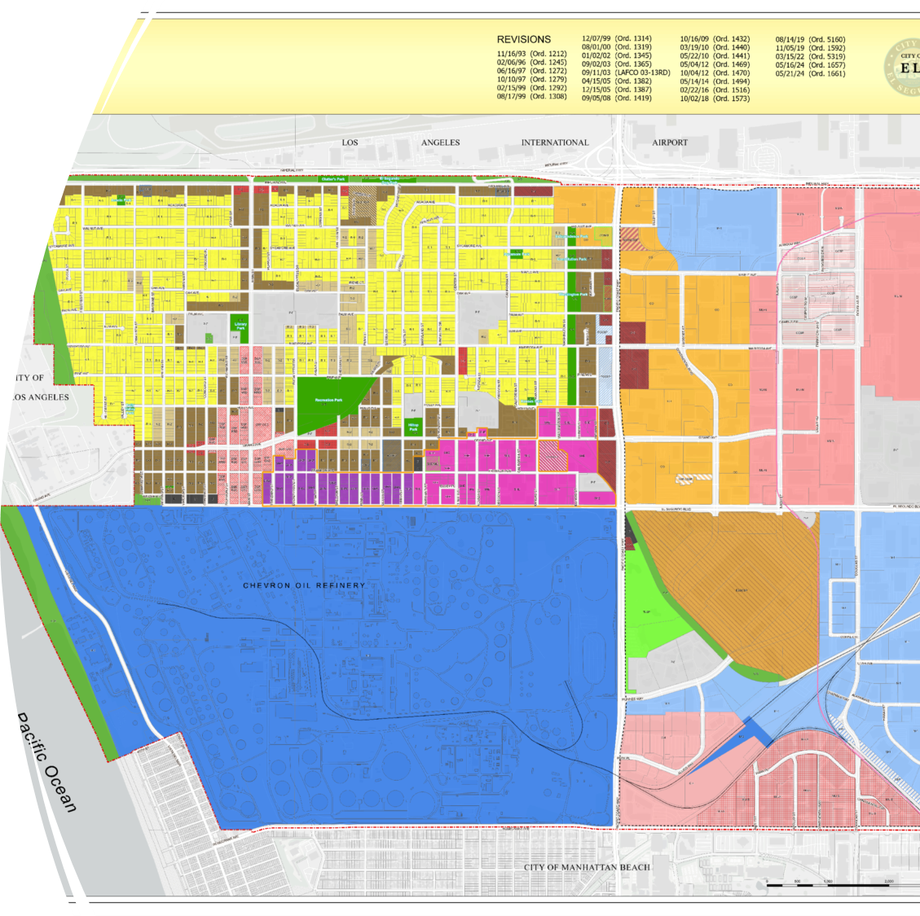
GP Land Use Element Update
Dictates the distribution, location, and extent of the uses of the land for housing, business, industry, open space, etc.
  Ex. Population density, building intensity, land use categories
Implemented through policies, zoning ordinances, and zoning map
  https://www.elsegundo.org/our-city/city-maps/city-map-gallery

Slide 4
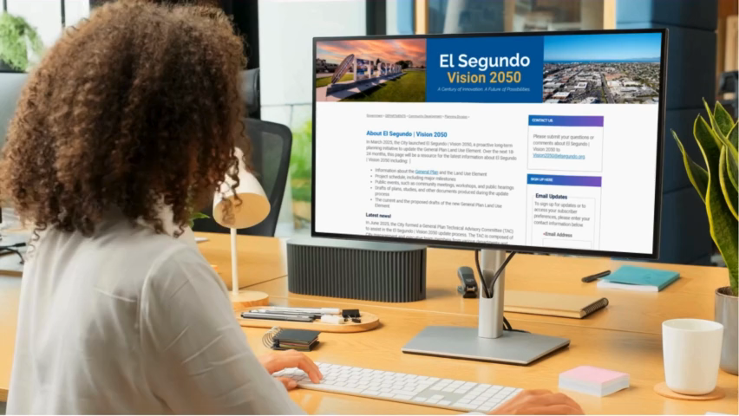
Accomplishments
City Tour
  April 4, 2025
  Project Name
  El Segundo Vision I 2050
Website
  https://www.elsegundo.org/government/departments/community-development/planning-division/vision-2050-city-of-el-segundo
City Leadership Interviews
  May 19-30, 2025

Slide 5
Engagement Plan Methods
City leadership interviews
Community Questionnaire
Public meetings and hearings
Community Workshops
Pop-up Events
Online Resources
Engagement Metrics and Dashboards

Slide 6


Engagement Metrics and Evaluations
Engagement Metrics
  (Attached in Engagement Plan page 10-11)
Community Questionnaire
  TAC Meeting #2

Slide 7


Project Phases and Timeline
1
2
3
Context & Vision
(Apr 2025- Oct 2025)
Discover, listen, and learn about the community from residents, businesses, and property owners. Prioritize a highly conversational mode of engagement to receive input and build connections between all groups.
Exploring Alternatives
(Sept 2025- Feb 2026)
Build from the discovery efforts to explore and conceptualize draft land use concepts, gather additional input and feedback from the community and City agencies, and align the draft policies with the community’s collective vision.
Future Foundations
(May 25- June 26)
Refine land use concepts ahead of presenting the draft Land Use Element for adoption.

Slide 8


Next Steps
Next TAC Meetings w/ Consultants
  After Existing Conditions Analysis
    July 31, 2025
  After formulated alternatives
  After draft Land Use Element
Community Workshop #1
  August 13, 2025
Notes:
Existing Conditions- Baseline of El Segundo to include a summary of identified challenges and opportunities to be addressed by the LUE update
Formulated Alternatives- Explore and conceptualize draft land use concepts after listening and learning from the community
Draft Land Use Element- This version of the plan will include all images, figures, and diagrams necessary to fully articulate the land use and policy concepts included in the Element.

Slide 9
Questions?

