Slide 1

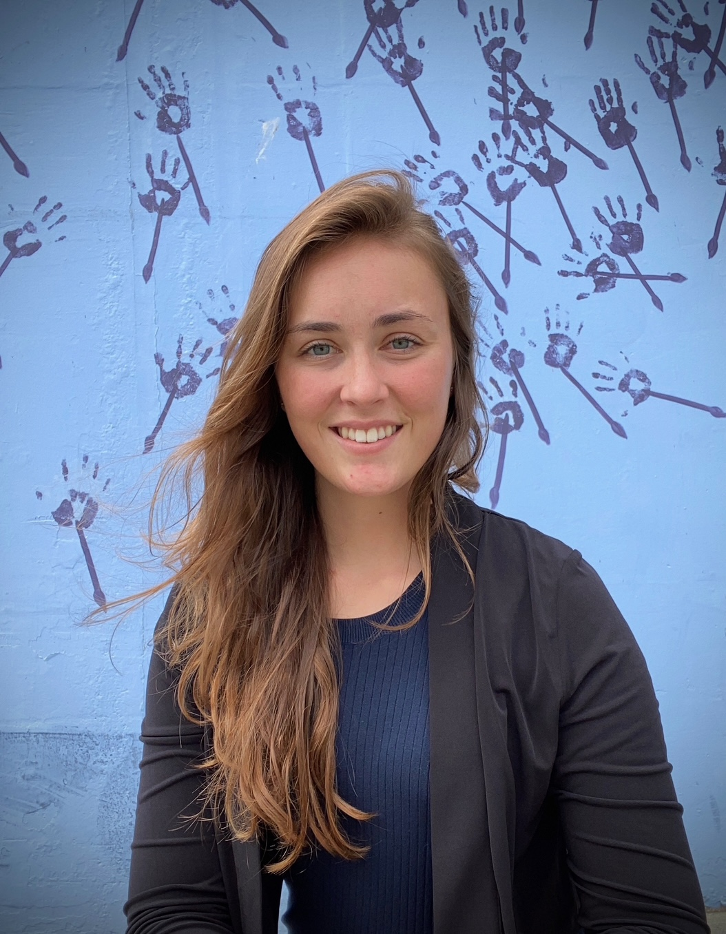
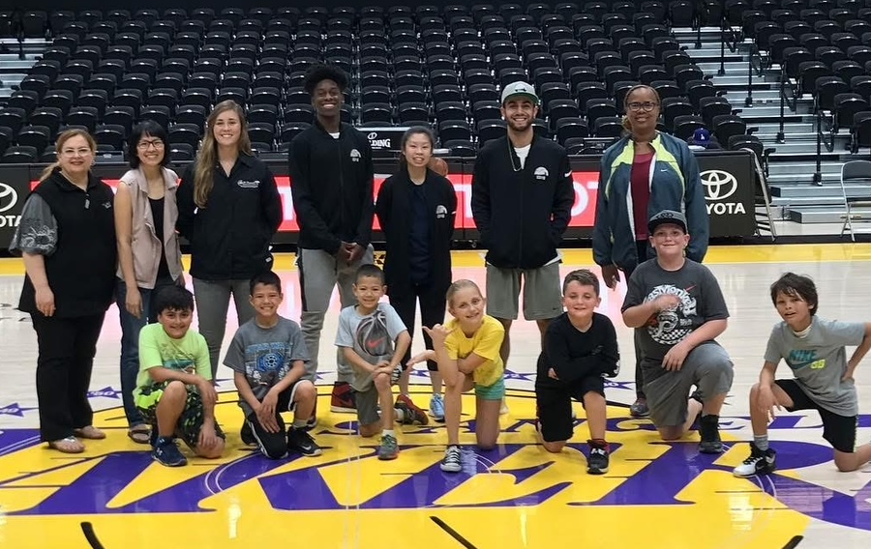
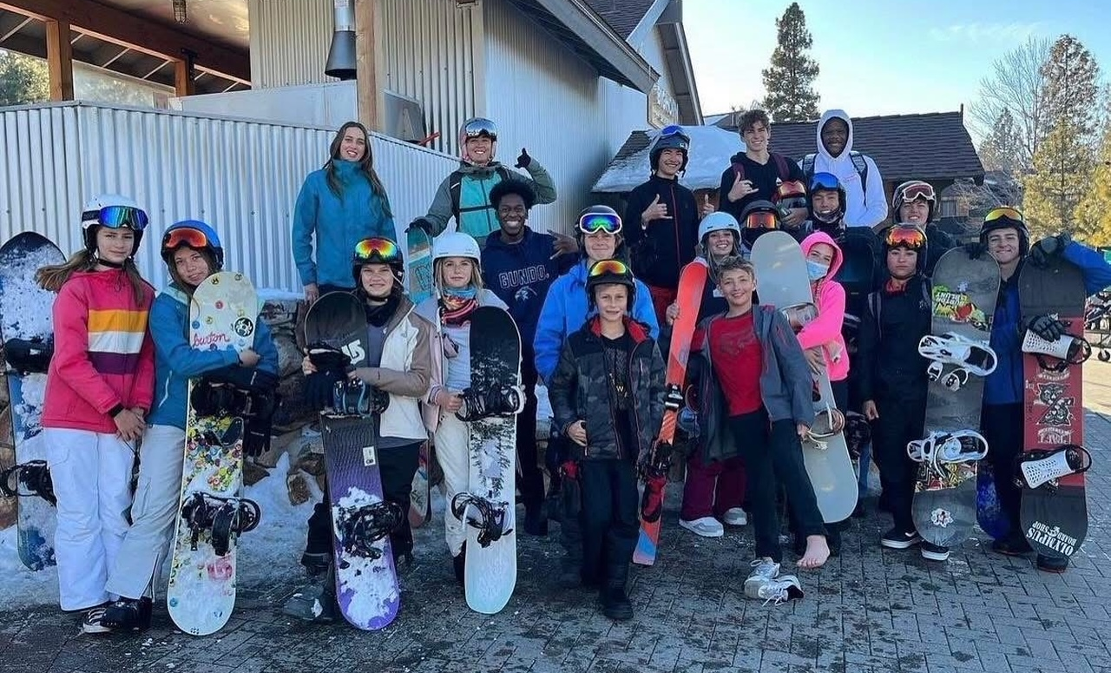
Employee Spotlight
2025 Recreation
Rachel Cummings
Recreation Supervisor Youth and Adult Sports Programs and Facilities

